Slide 1
Final Project-Option A
Caty Nava, Tristan Miranda, Brandon Bartos

Slide 2
Python Closures
(exec 'import Onlystring; toReturn = Onlystring.create_creature()')
We have a Creature class that is extended by the Human class.
When the project executes, it calls a creature_create function that creates a human object.

Slide 3
Stream Operations
Goals :
Import a file
Read that file
Store it in an ArrayList
Stream through that ArrayList
Print results

Slide 4
Stream Operations
(exec 'import Stream; toReturn = Stream.main()')

Slide 5
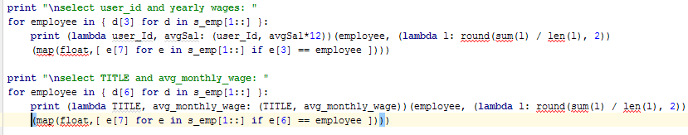
Python Lambda
(exec 'import Lambda; toReturn = Lambda.main()')
Goals:
Produce yearly wage by username
Generate average salary by title

Slide 6
Swift Parser
Main focus:
-Variables declared with “let” and “var”
-Optional Values
Let variable can never be changed unless they were previously declared as an Optional Value.
Var variables can be changed any number of times. These variables CANNOT be made permanent by using the “let” function.

Slide 7
Challenges
Creating/compiling Java classes
IntelliJ reports problems that might not be there?
Finding and learning how the exec() function worked
File organization
Working with specific types (aka “wont accept int/string/etc..”)

Slide 8

Bugs and Fixes
Bugs
IntelliJ shows coding errors and won’t allow you to import Java libraries
Compiling classes w/o the command line would delete the .java files when exiting
When we tried passing objects to our closure, we would get a Nameerror and we couldn’t resolve it.
Fixes
Couldn’t find one so we had to ignore it
Used the “javac filenme.java” command in terminal
Had to hard code values for the object to draw on.

Slide 9
Demo time..
Thank you, Professor Cannata

